Slide 1
INTRODUCTION TO INFORMATION TECHNOLOGY (Midterm Report)
喬伊 4100E219

Slide 2
AGENDA
PYTHON PROGRAMMING
50 PAGES

Slide 3
PHYTON PROGRAMMING

Slide 4
Python Data Types

Slide 5
Built-in Data Type
In programming, data type is an important concept.
Variables can store data of different types, and different types can do different things

Slide 6
Python has the following data types built-in by default, in these categories:
Text Type: | str
Numeric Types: | int, float, complex
SequenceType: | list, tuple, range
Mapping Type: | dict
Set Types: | set, frozenset
Boolean Type: | bool
Binary Types: | bytes, bytearray, memoryview

Slide 7
Text Type
Text data type is known as Strings in Python. Strings can contain numbers and / or characters. For example, a string might be a word, a sentence, or several sentences.
x = "Hello World“

Slide 8
NUMERIC DATA TYPE
Represent the data which has numeric value. Numeric value can be integer, floating number or even complex numbers. These values are defined as int , float and complex class in Python.
x = 20 | int
x = 20.5 | float
x = 1j | complex

Slide 9
SEQUENCE DATA TYPE
Sequences allow you to store multiple values in an organized and efficient fashion. There are several sequence types: lists, tuples, and range objects.
x = ["apple", "banana", "cherry"] | list
x = ("apple", "banana", "cherry") | tuple
x = range(6) | range

Slide 10
MAPPING DATA TYPE
A mapping type is a data type comprised of a collection of keys and associated values. Python's only built-in mapping type is the dictionary.
x = {"name" : "John", "age" :36} | dict

Slide 11
SET DATA TYPE
Set is an unordered collection of unique items. Set is defined by values separated by comma inside braces { }. Items in a set are not ordered.
x = {"apple", "banana", "cherry"} | set
x = frozenset({"apple", "banana", "cherry"}) | frozenset

Slide 12
BOOLEAN DATA TYPE
One of the built-in data types provided by Python, which represents one of the two values i.e. True or False. Generally, it is used to represent the truth values of the expressions. For example, 1== 0 is True whereas 2<1 is False.
x = True | bool

Slide 13
BINARY DATA TYPE
Bytes and bytearray are used for manipulating binary data. The memoryview uses the buffer protocol to access the memory of other binary objects without needing to make a copy.
x = b"Hello" | bytes
x = bytearray(5) | bytearray
x = memoryview(bytes(5)) | memoryview

Slide 14
Python If ... Else

Slide 15
Python Conditions and If statements
Python supports the usual logical conditions from mathematics:
Equals: a == b
Not Equals: a != b
Less than: a < b
Less than or equal to: a <= b
Greater than: a > b
Greater than or equal to: a >= b

Slide 16
These conditions can be used in several ways, most commonly in "if statements" and loops.
An "if statement" is written by using the if keyword.
Example
If statement:
a = 33 b = 200 if b > a: print("b is greater than a")
In this example we use two variables, a and b, which are used as part of the if statement to test whether b is greater than a. As a is 33, and b is 200, we know that 200 is greater than 33, and so we print to screen that "b is greater than a".

Slide 17
Indentation
Python relies on indentation (whitespace at the beginning of a line) to define scope in the code. Other programming languages often use curly-brackets for this purpose.
Example
If statement, without indentation (will raise an error):
a = 33 b = 200 if b > a: print("b is greater than a") # you will get an error

Slide 18
ELIF
The elif keyword is pythons way of saying "if the previous conditions were not true, then try this condition".
Example
a = 33 b = 33 if b > a: print("b is greater than a") elif a == b: print("a and b are equal")
In this example a is equal to b, so the first condition is not true, but the elif condition is true, so we print to screen that "a and b are equa

Slide 19
ELSE
The else keyword catches anything which isn't caught by the preceding conditions.
Example
a = 200 b = 33 if b > a: print("b is greater than a") elif a == b: print("a and b are equal") else: print("a is greater than b")

Slide 20
Short Hand If
If you have only one statement to execute, you can put it on the same line as the if statement.
Example
One line if statement:
if a > b: print("a is greater than b")

Slide 21
Short Hand If ... Else
If you have only one statement to execute, one for if, and one for else, you can put it all on the same line:
Example
One line if else statement:
a = 2 b = 330 print("A") if a > b else print("B")

Slide 22
And
The and keyword is a logical operator, and is used to combine conditional statements:
Example
Test if a is greater than b, AND if c is greater than a:
a = 200 b = 33 c = 500 if a > b and c > a: print("Both conditions are True")

Slide 23
Or
The or keyword is a logical operator, and is used to combine conditional statements:
Example
Test if a is greater than b, OR if a is greater than c:
a = 200 b = 33 c = 500 if a > b or a > c: print("At least one of the conditions is True")

Slide 24
Nested If
You can have if statements inside if statements, this is called nested if statements.
Example
x = 41 if x > 10: print("Above ten,") if x > 20: print("and also above 20!") else: print("but not above 20.")

Slide 25
The pass Statement
if statements cannot be empty, but if you for some reason have an if statement with no content, put in the pass statement to avoid getting an error.
Example
a = 33 b = 200 if b > a: pass

Slide 26
Python While Loops

Slide 27
PYTHON LOOPS
Python has two primitive loop commands:
while loops
for loops

Slide 28
The while Loop
With the while loop we can execute a set of statements as long as a condition is true.
Example
Print i as long as i is less than 6:
i = 1 while i < 6: print(i) i += 1

Slide 29
The break Statement
With the break statement we can stop the loop even if the while condition is true:
Example
Exit the loop when i is 3:
i = 1 while i < 6: print(i) if i == 3: break

Slide 30
The continue Statement
With the continue statement we can stop the current iteration, and continue with the next:
Example
Continue to the next iteration if i is 3:
i = 0 while i < 6: i += 1 if i == 3: continue print(i)

Slide 31
The else Statement
With the else statement we can run a block of code once when the condition no longer is true:
Example
Print a message once the condition is false:
i = 1 while i < 6: print(i) i += 1 else: print("i is no longer less than 6")

Slide 32
Python For Loops
A for loop is used for iterating over a sequence (that is either a list, a tuple, a dictionary, a set, or a string).
Example
Print each fruit in a fruit list:
fruits = ["apple", "banana", "cherry"] for x in fruits: print(x)

Slide 33
Looping Through a String
Even strings are iterable objects, they contain a sequence of characters:
Example
Loop through the letters in the word "banana":
for x in "banana": print(x)

Slide 34
Break Statement
With the break statement we can stop the loop before it has looped through all the items:
Example
Exit the loop when x is "banana":
fruits = ["apple", "banana", "cherry"] for x in fruits: print(x) if x == "banana": break

Slide 35
The continue Statement
With the continue statement we can stop the current iteration of the loop, and continue with the next:
Example
Do not print banana:
fruits = ["apple", "banana", "cherry"] for x in fruits: if x == "banana": continue print(x)

Slide 36
The range() Function
To loop through a set of code a specified number of times, we can use the range() function,
The range() function returns a sequence of numbers, starting from 0 by default, and increments by 1 (by default), and ends at a specified number.
Example
Using the range() function:
for x in range(6): print(x)

Slide 37
Else in For Loop
The else keyword in a for loop specifies a block of code to be executed when the loop is finished:
Example
Print all numbers from 0 to 5, and print a message when the loop has ended:
for x in range(6): print(x) else: print("Finally finished!")

Slide 38
Nested Loops
A nested loop is a loop inside a loop.
The "inner loop" will be executed one time for each iteration of the "outer loop":
Example
Print each adjective for every fruit:
adj = ["red", "big", "tasty"] fruits = ["apple", "banana", "cherry"] for x in adj: for y in fruits: print(x, y)

Slide 39
The pass Statement
for loops cannot be empty, but if you for some reason have a for loop with no content, put in the pass statement to avoid getting an error.
Example
for x in [0, 1, 2]: pass

Slide 40
Infinite Loop
An Infinite Loop in Python is a continuous repetitive conditional loop that gets executed until an external factor interferes in the execution flow, like insufficient CPU memory, a failed feature/ error code that stopped the execution, or a new feature in the other legacy systems that needs code integration.

Slide 41
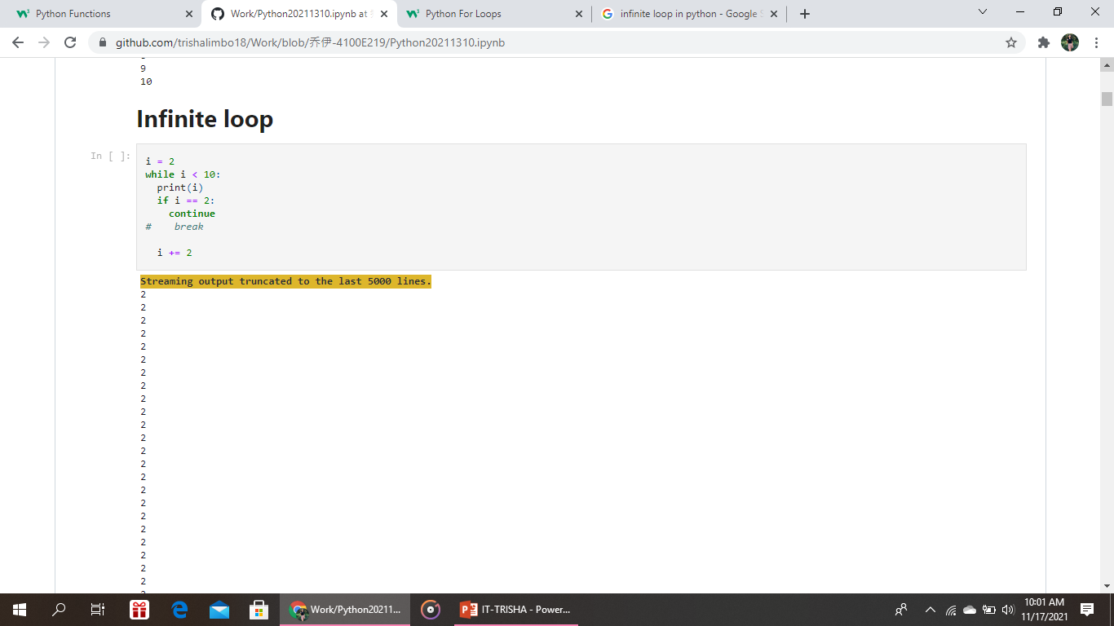
Infinite loop Example

Slide 42
Python Functions

Slide 43
Python Functions
A function is a block of code which only runs when it is called.
You can pass data, known as parameters, into a function.
A function can return data as a result.

Slide 44
Creating a Function
In Python a function is defined using the def keyword:
Example
def my_function(): print("Hello from a function")

Slide 45
Arguments
Information can be passed into functions as arguments.
Arguments are specified after the function name, inside the parentheses. You can add as many arguments as you want, just separate them with a comma.
The following example has a function with one argument (fname). When the function is called, we pass along a first name, which is used inside the function to print the full name:
Example
def my_function(fname): print(fname + " Refsnes") my_function("Emil") my_function("Tobias") my_function("Linus")

Slide 46
Use Default Arguments
Python has a different way of representing syntax and default values for function arguments. Default values indicate that the function argument will take that value if no argument value is passed during the function call. The default value is assigned by using the assignment(=) operator of the form keywordname=value.
printArea()
width: 18 height: 20 area: 360

Slide 47
use Keyword arguments
Keyword arguments (or named arguments) are values that, when passed into a function, are identifiable by specific parameter names. A keyword argument is preceded by a parameter and the assignment operator, = .
printArea(width = 18, height = 20)
width: 18 height: 20 area: 360
printArea(height = 20, width = 18)
width: 18 height: 20 area: 360

Slide 48
use Positional arguments
Positional arguments are values that are passed into a function based on the order in which the parameters were listed during the function definition.
printArea(18,20)
width: 18 height: 20 area: 360
printArea(20,18)
width: 20 height: 18 area: 360

Slide 49
Python Lambda

Slide 50
Power of Lambda Function
The power of lambda is better shown when you use them as an anonymous function inside another function.
Example
def myfunc(n): return lambda a : a * n mydoubler = myfunc(2) mytripler = myfunc(3) print(mydoubler(11)) print(mytripler(11))

